Slide 1
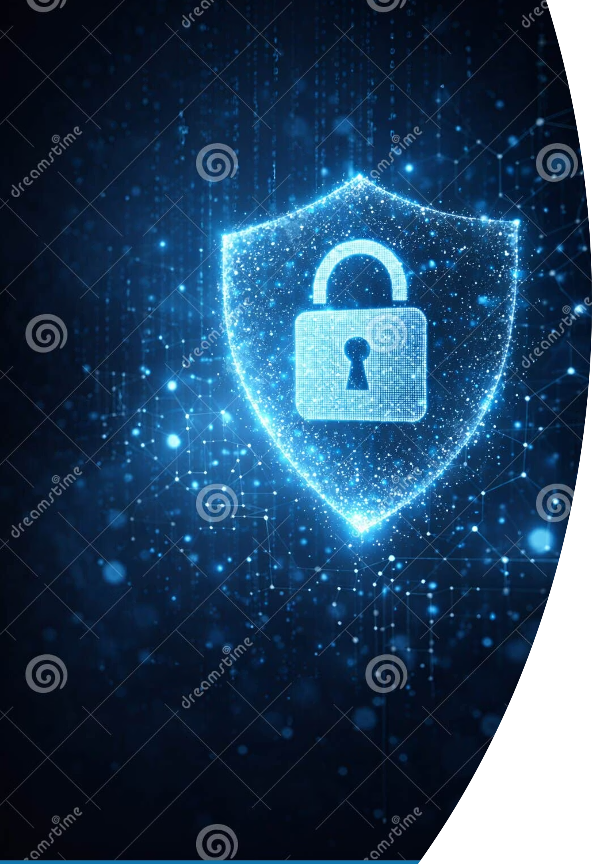
Phishing Awareness: Become a Digital Defender
Every day, millions of phishing attempts target real people. Learn to recognize the bait, understand the tactics, and protect yourself — and your organization — from cyber threats.

Slide 2
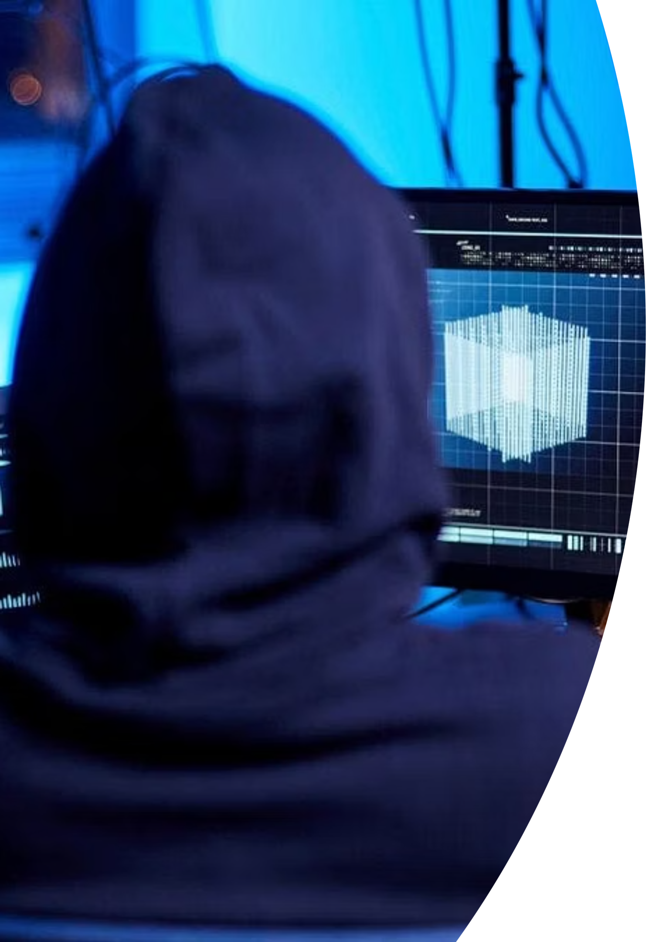
What is Phishing? The Art of Deception
The Tactic
The Goal
Attackers impersonate trustworthy entities — banks, colleagues, or government agencies — to gain your confidence.
Trick you into revealing passwords, credit card numbers, or personal data for financial gain.
The Method
A form of social engineering — manipulating human psychology rather than exploiting technical flaws.

Slide 3

The Scale of the Threat
94%
$4.45M
1 in 3
Malware via Email
Average Breach Cost
Users Targeted
Of detected malware is delivered through phishing emails. (CyberNut)
The average cost of a data breach in 2023, driven largely by phishing incidents.
One in three internet users will experience a phishing attempt in their lifetime.
Falling victim can lead to data breaches, identity theft, and devastating financial loss — for both individuals and organizations.

Slide 4
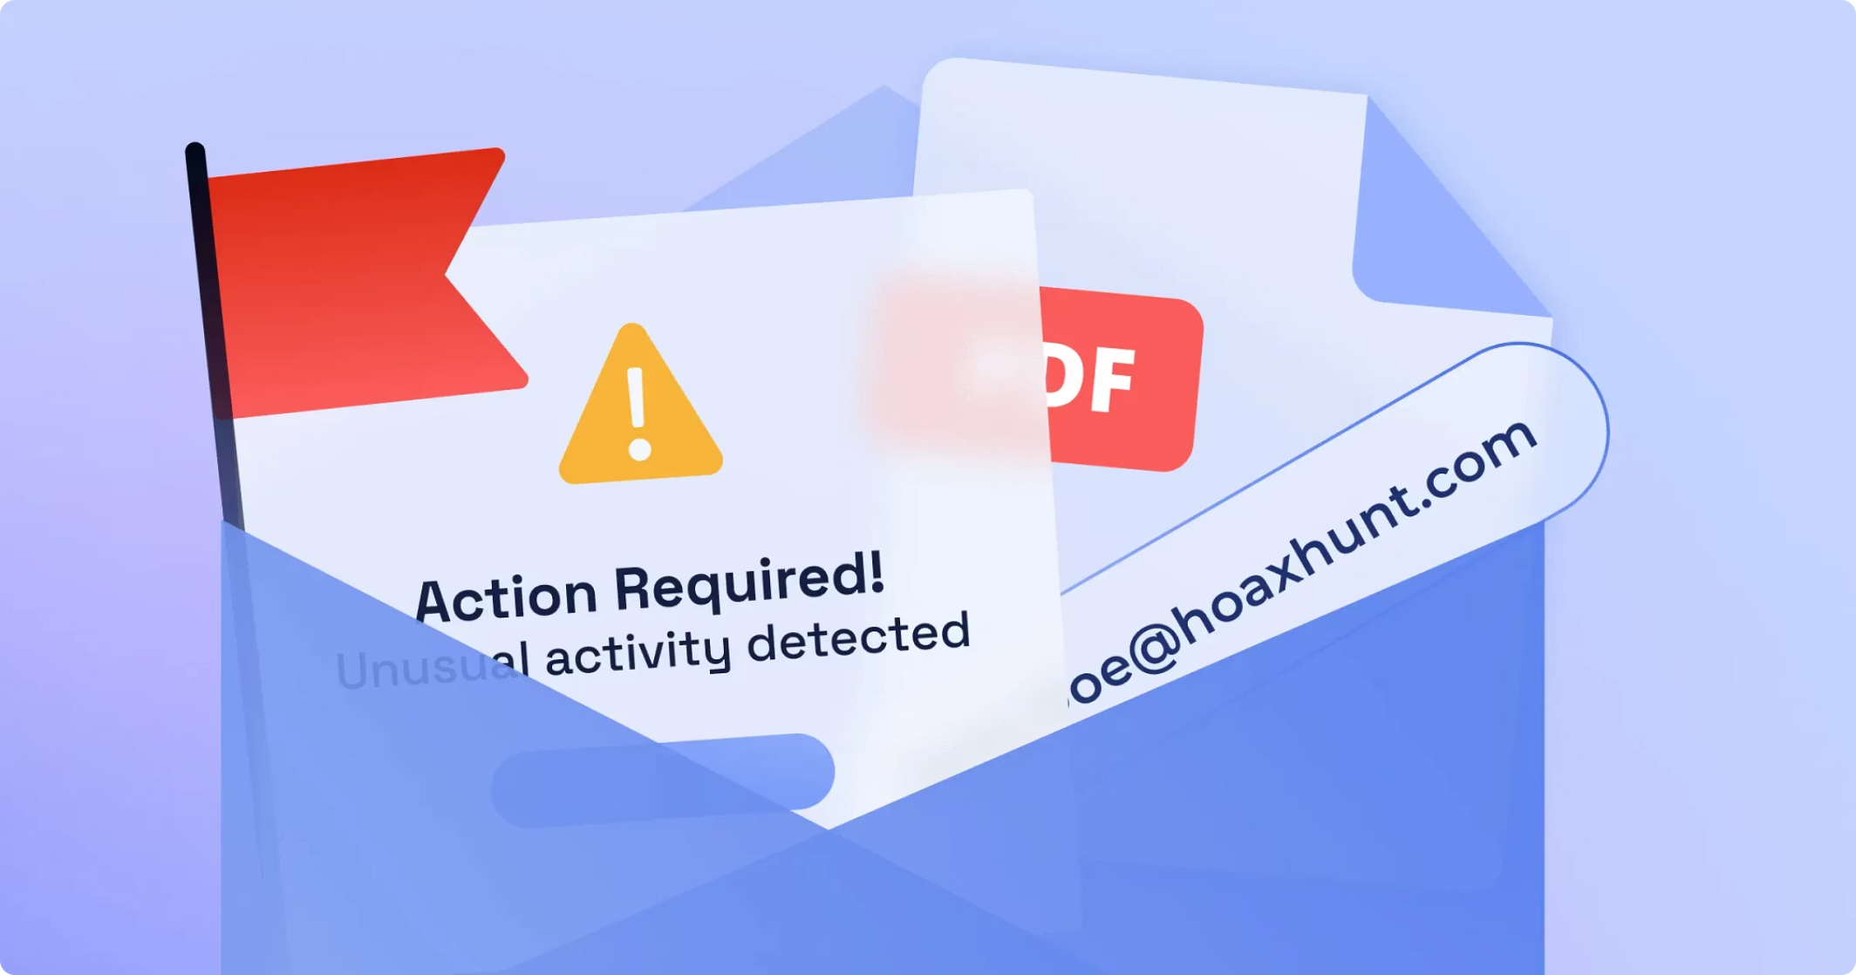
Recognizing the Bait: Spotting Phishing Emails
🎣 Suspicious Sender
Mismatched addresses or generic greetings like "Dear Customer."
⚡ Urgency & Threats
"Your account will be terminated" — designed to rush your judgment.
✍️ Poor Grammar
Unprofessional language or spelling errors are major red flags.
🔗 Unexpected Links
Never click links or open attachments from unknown sources.

Slide 5
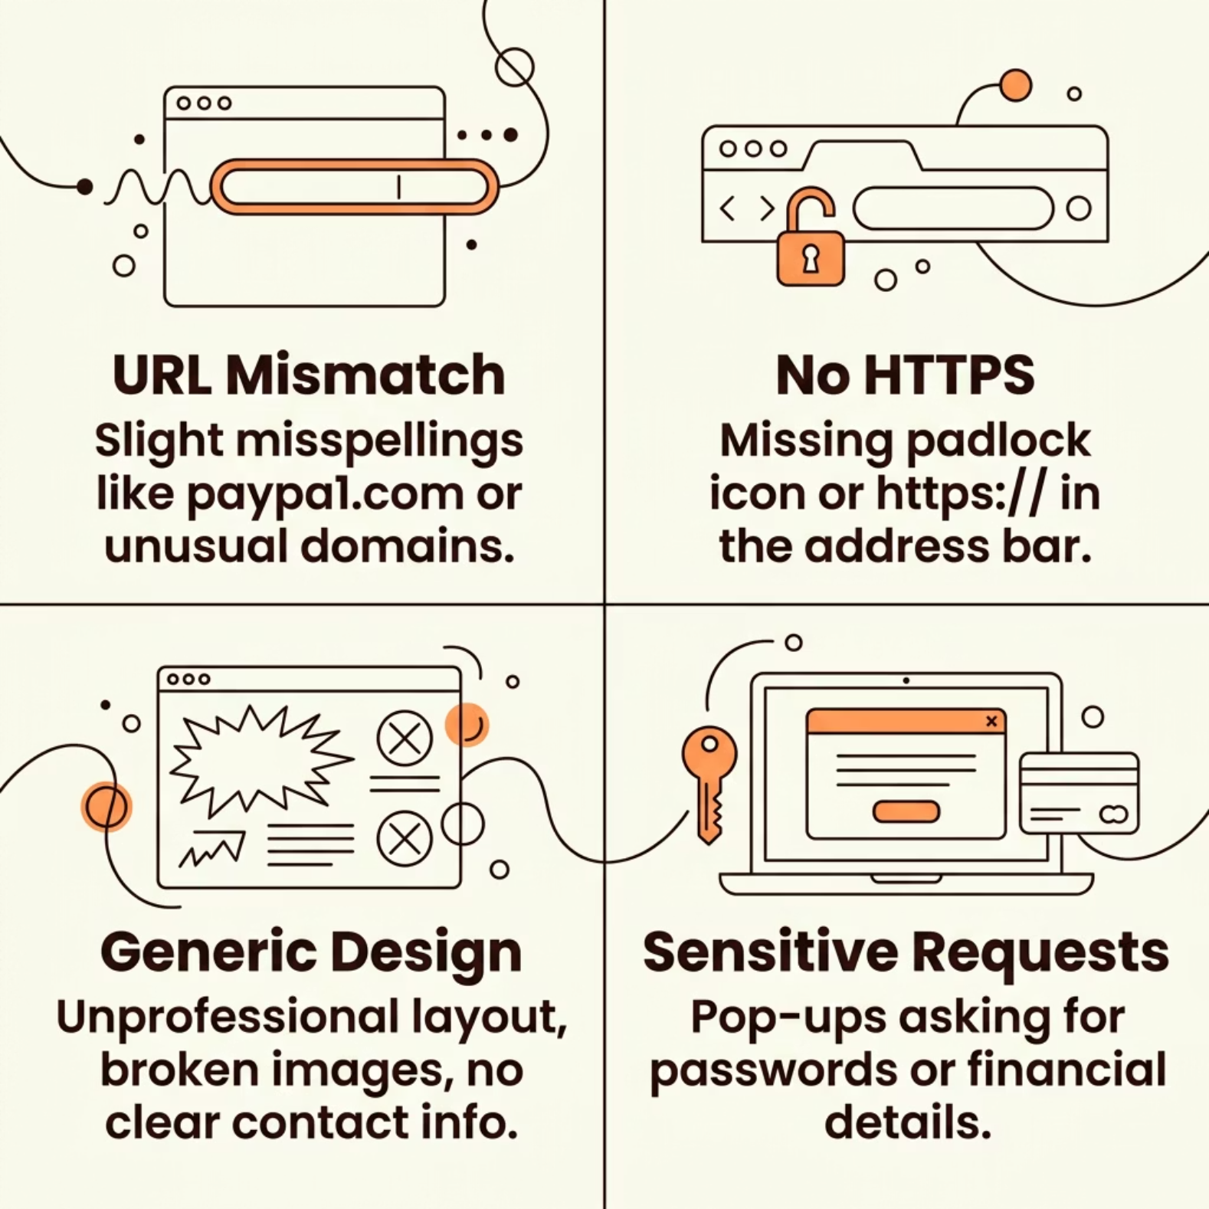

Navigating the Illusion: Identifying Fake Websites
How to Verify a Website
Before entering any credentials or personal data, take 30 seconds to inspect the page.
Hover over links to reveal the actual URL before clicking
Look for https:// and the padlock icon in your browser
Check for detailed contact information and professional design
Legitimate sites rarely ask for passwords via pop-ups or unsolicited forms

Slide 6

The Social Engineer's Playbook
Fear
Creates panic to bypass critical thinking. "Your account is compromised — act now!"
Curiosity
Piques interest with enticing offers or shocking news. "You've won a prize!"
Excitement
Promises rewards or exclusive access to encourage immediate action. "Click here for a free gift!"
Impersonation
Pretending to be a known company, government agency, or even a colleague you trust.

Slide 7
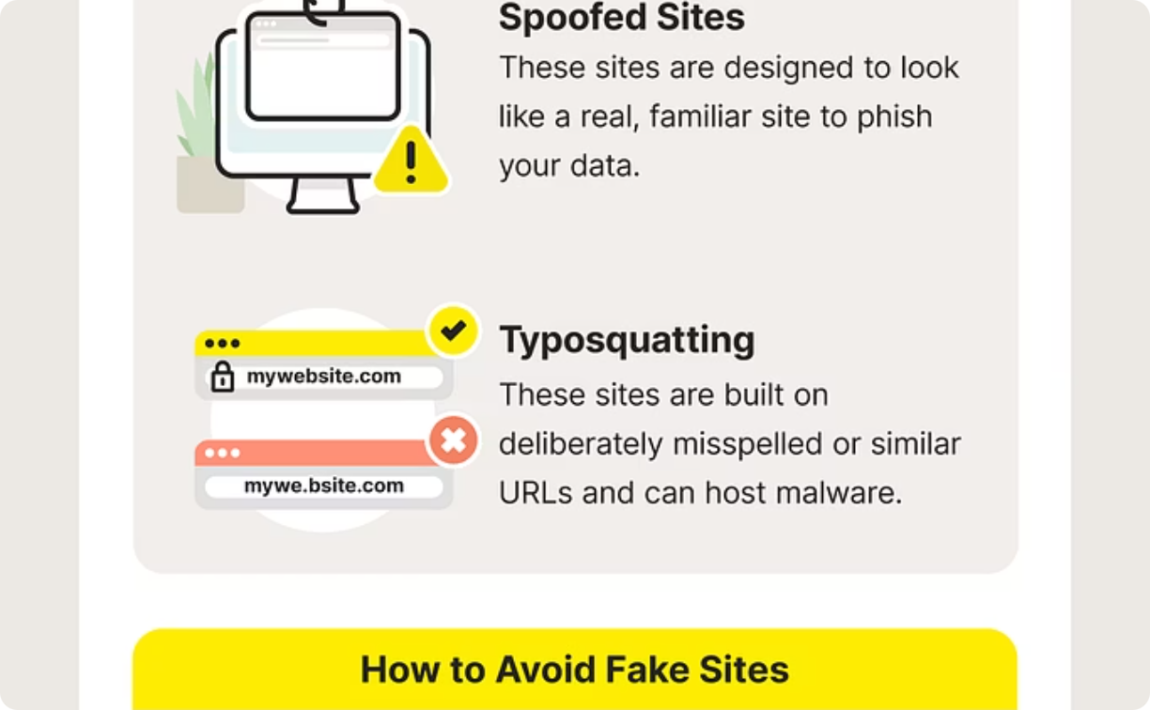
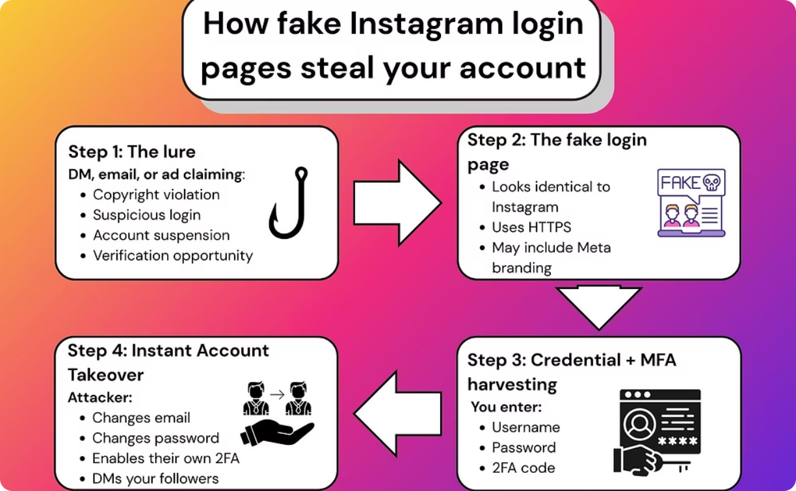

Spot the Difference: Your Security Depends On It
Fake login pages can look almost identical to legitimate ones. A single character difference in the URL is all it takes.
✅ Legitimate Site
🚨 Fake Site
Correct URL, HTTPS enabled, professional design, official contact details visible.
Slight URL misspelling, no HTTPS, generic layout, requests credentials via pop-up.
Always check the URL bar before entering any credentials — even if the page looks perfectly familiar.

Slide 8
Your Shield: Best Practices to Stay Safe
01
02
03
Think Before You Click
Verify Independently
Use Strong, Unique Passwords
Pause and scrutinize every unexpected message — even from known senders.
Contact the supposed sender through a trusted, official channel.
Employ a password manager to generate and store complex credentials.
04
05
Enable Multi-Factor Authentication (MFA)
Keep Software Updated
Adds a critical second layer of security beyond just a password.
Patches fix vulnerabilities attackers actively exploit.

Slide 9
Interactive Quiz: Test Your Phishing Smarts!
SCENARIO 1
SCENARIO 2
The Netflix Email
The Free iPhone Text
You receive an email from "Netflix Support" saying your payment failed, with a link to update your card.
What do you do?
A text claims you've won a free iPhone and asks you to click a link to claim it.
What's the best action?
A) Click the link and update your card
B) ✅ Log in directly through the official Netflix website
C) Reply with your credit card info
A) Click the link immediately
B) Forward to your friends
C) ✅ Delete the message and block the sender

Slide 10
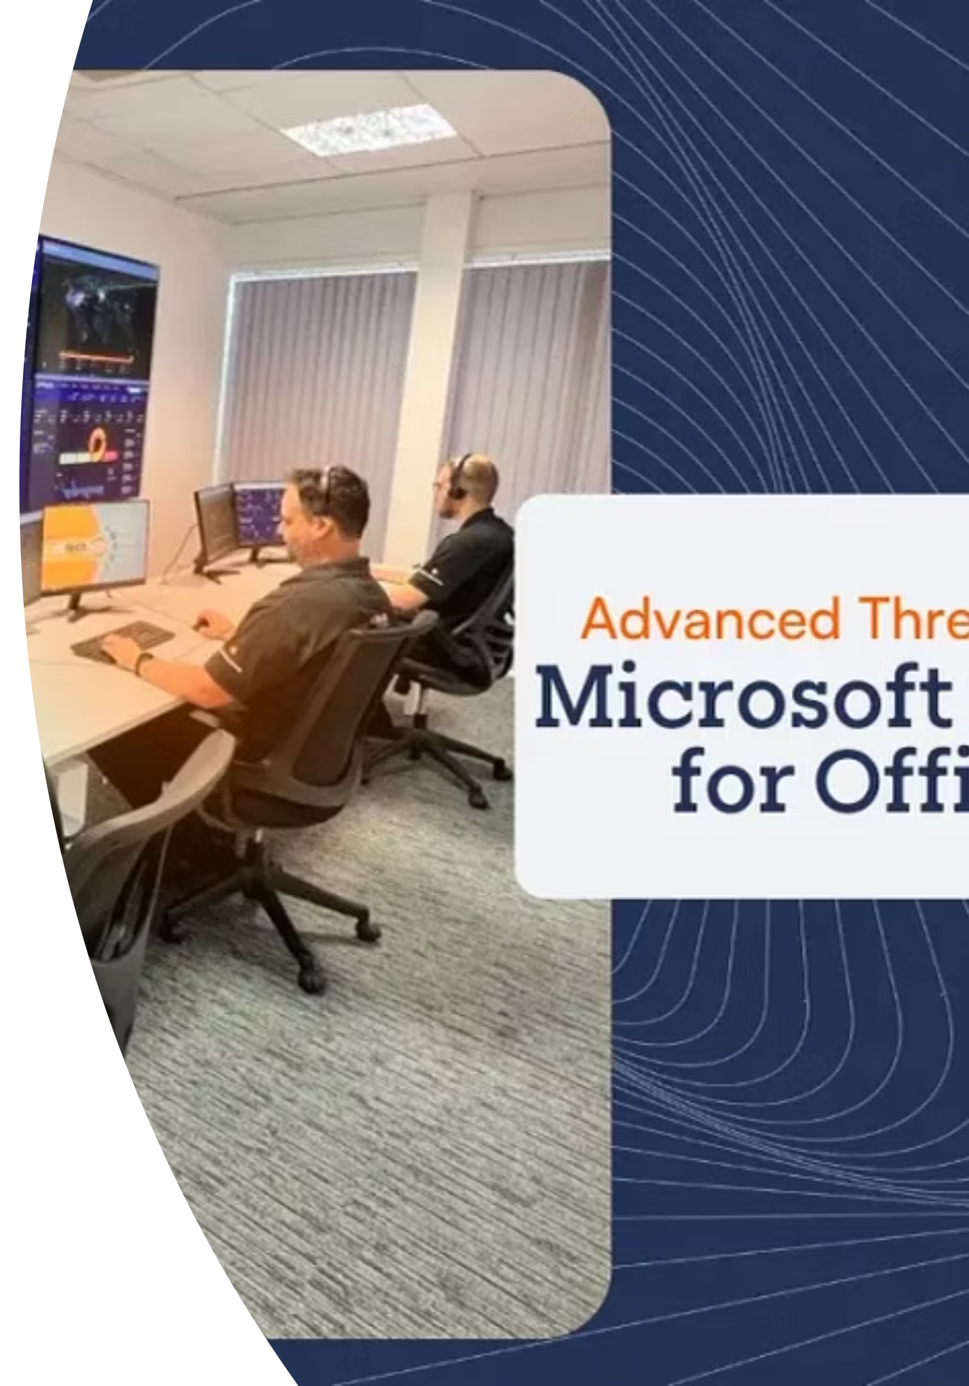

You Are the First Line of Defense
Phishing attacks prey on human error — but awareness is your strongest weapon.
🔍 Recognize
🧠 Understand
Know the signs: suspicious senders, urgency, poor grammar, and fake URLs.
Learn the tactics — fear, curiosity, excitement, and impersonation.
🛡️ Act
Practice safe habits: verify, use MFA, and keep software updated.
Stay vigilant, stay informed, and stay safe online. Your awareness protects not just you — but your entire organization.

